Slide 1
K.S.Rangasamy College of Technology
VIRTUSA JATAYU
STOCK MARKET PREDICTION USING PYTHON
A NEURAL NETWORK APPROACH TO PREDICT
STOCK MARKET PRICES.
PRESENTED BY
Team : BRO's

Slide 2
PROBLEM DESCRIPTION K.S.Rangasamy College Of Technology
Collect a sufficient amount of historical stock data.
Using the data, train a neural network.
We have used the CNN and LSTM algorithm for the prediction of the data.
Once trained, the neural network can be used to predict stock prices.
Predicted result will be displayed in the webapp that we have created.

Slide 3
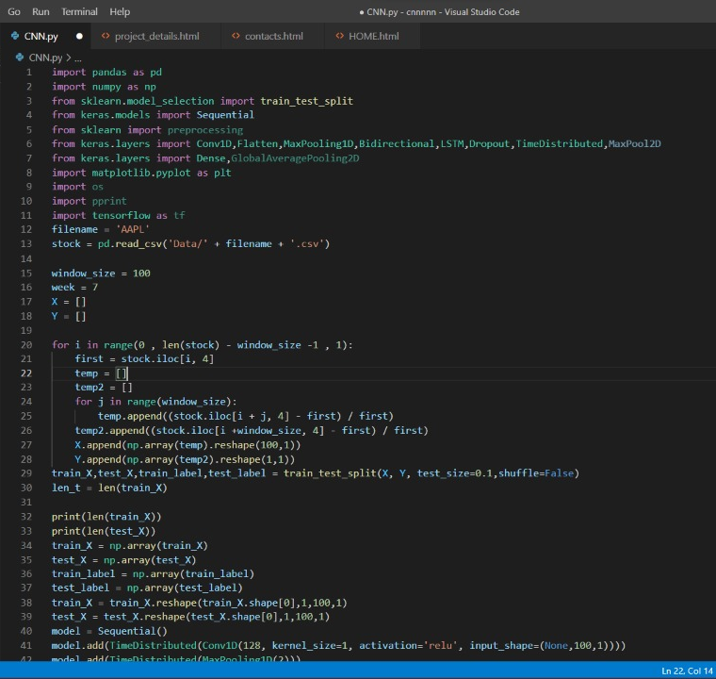
PROJECT CODE:
K.S.Rangasamy College Of Technology
This is the source program of our project, which was implemented for the prediction.

Slide 4
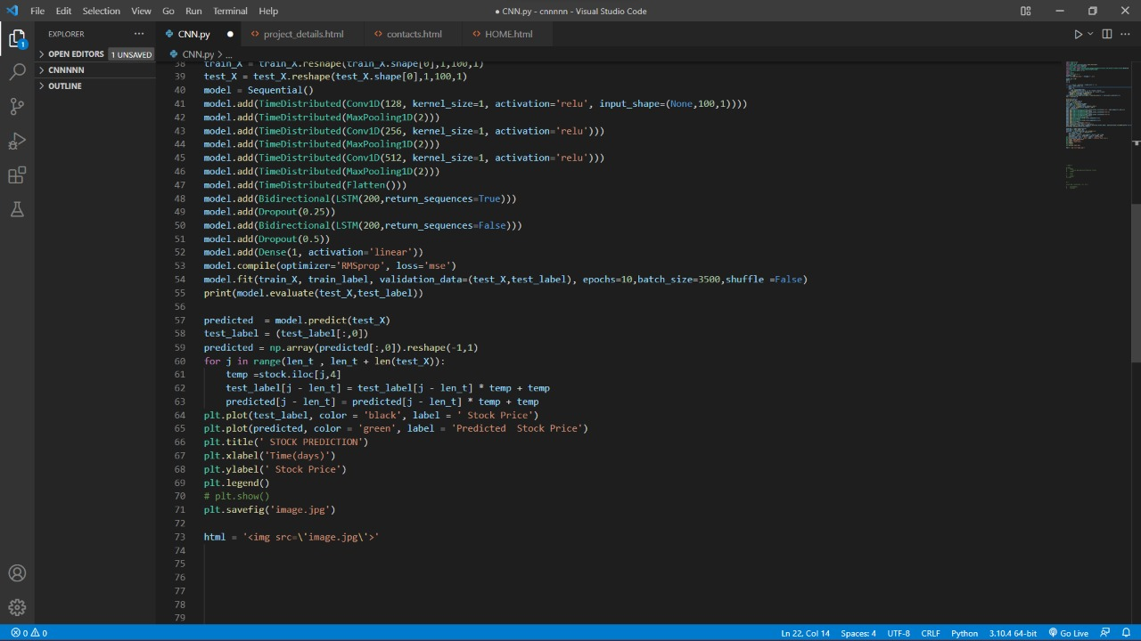
PROJECT CODE
K.S.Rangasamy College Of Technology

Slide 5
RESULT OF THE PROJECT
K.S.Rangasamy College Of Technology

Slide 6
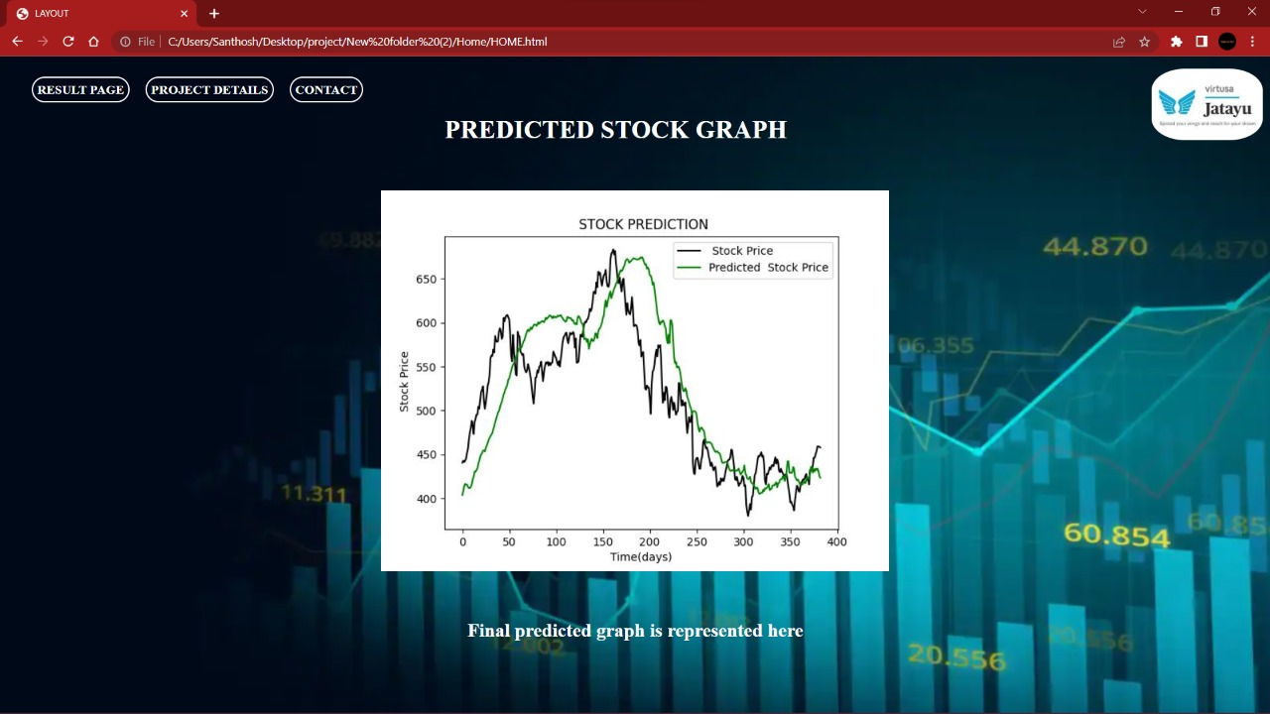
RESULT PAGE
K.S.Rangasamy College Of Technology
This is the Result page of our project,which shows the graph of the predicted data.

Slide 7
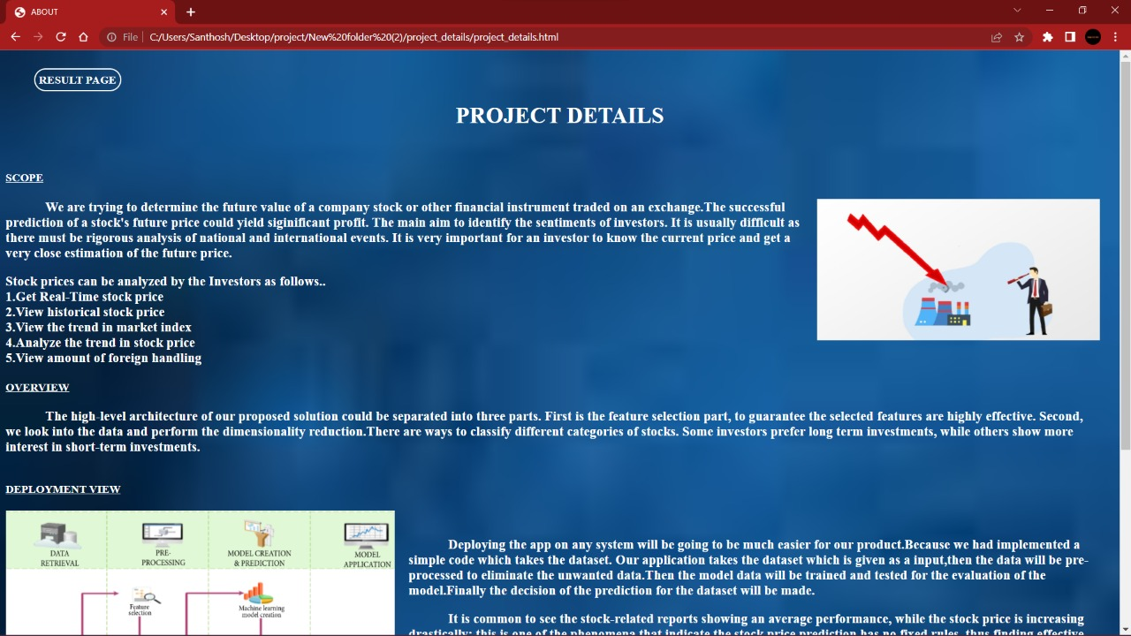
DESCRIPTION PAGE
K.S.Rangasamy College Of Technology

Slide 8
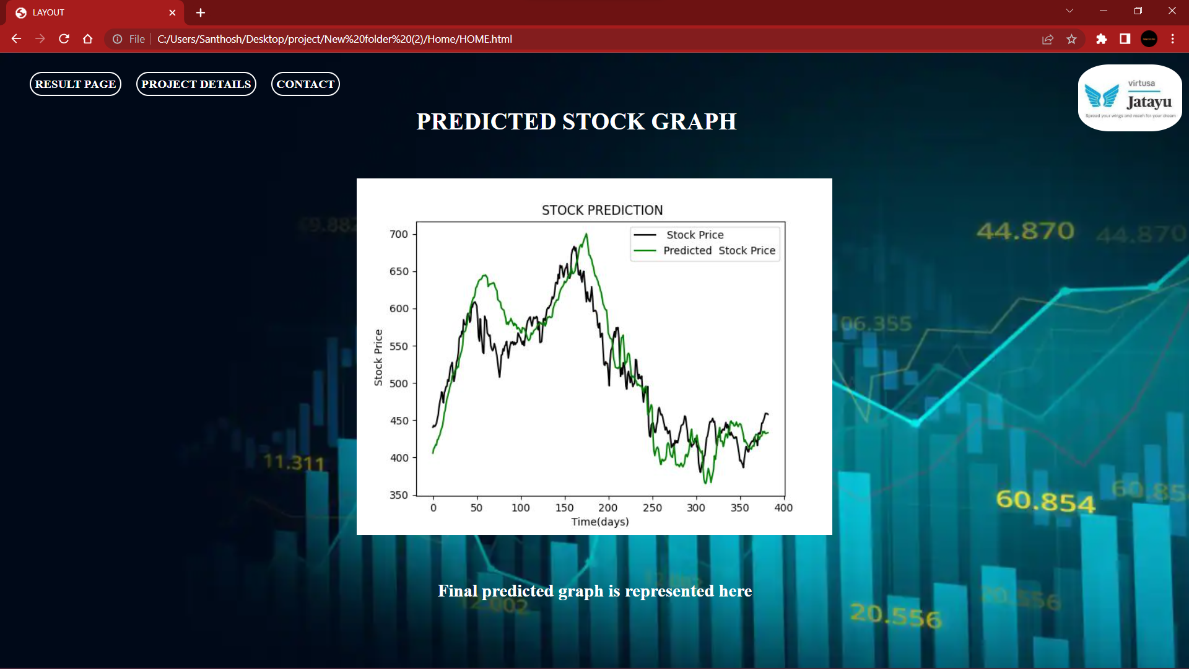
VARIOUS OUTPUT

Slide 9
THANK YOU
K.S.Rangasamy College Of Technology

